Slide 1

#RahoAmbitious
Full Stack Development

Slide 2


Course : Full Stack Development
Lecture On Unit Testing
Instructor :

Slide 3
What we will be learning
1
Introduction: Unit Testing
2
What Is a Unit and What Do We Unit Test?
3
Unit Test Cases, JUnit and Its Configurations
4
Assertions in Unit Testing

Slide 4
Introduction: Unit Testing
Unit testing involves the testing of each unit or an individual component of the software application. It is the first level of functional testing. The aim behind unit testing is to validate unit components with its performance.
Whenever the application is ready and given to the Test engineer, he/she will start checking every component of the module or module of the application independently or one by one, and this process is known as Unit testing or components testing.

Slide 5
What Do We Unit Test?
Unit testing helps tester and developers to understand the base of code that makes them able to change defect causing code quickly.
Unit testing helps in the documentation.
Unit testing fixes defects very early in the development phase that's why there is a possibility to occur a smaller number of defects in upcoming testing levels.
It helps with code reusability by migrating code and test cases.

Slide 6
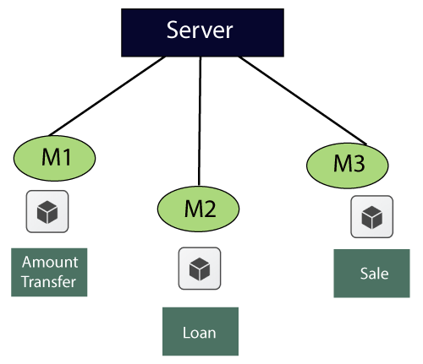
Example

Slide 7
Example
1. | Amount transfer
1.1 | From account number (FAN)→ Text Box
1.1.1 | FAN→ accept only 4 digit
1.2 | To account no (TAN)→ Text Box
1.2.1 | TAN→ Accept only 4 digit
1.3 | Amount→ Text Box
1.3.1 | Amount → Accept maximum 4 digit
1.4 | Transfer→ Button
1.4.1 | Transfer → Enabled
1.5 | Cancel→ Button
1.5.1 | Cancel→ Enabled

Slide 8
JUnit and Its Configurations
Local Environment Setup. ...
Step 1: Verify Java Installation in Your Machine. ..
Step 2: Set JAVA Environment. ...
Step 3: Download JUnit Archive. ...
Step 4: Set JUnit Environment. ...
Step 5: Set CLASSPATH Variable. ...
Step 6: Test JUnit Setup. ...
Step 7: Verify the Result.

Slide 9
Assertions
What is Assertion based testing?
An assertion is a boolean expression at a specific point in a program which will be true unless there is a bug in the program. A test assertion is defined as an expression, which encapsulates some testable logic specified about a target under test.
Benefits of Assertions:
The main advantage of having assertions is to identify defects in a program. The usefulness of assertions include:
It is used to detect subtle errors which might go unnoticed.
It is used to detect errors sooner after they occur.
Make a statement about the effects of the code that is guaranteed to be true

Slide 10
#RahoAmbitious
Thank You!

